Slide 1
COMP 5352 -1 Advanced Internetworking Technology
North American university spring, 2021 kanybek duisheev ph.d
Ali USTUNKOL final project presentation

Slide 2
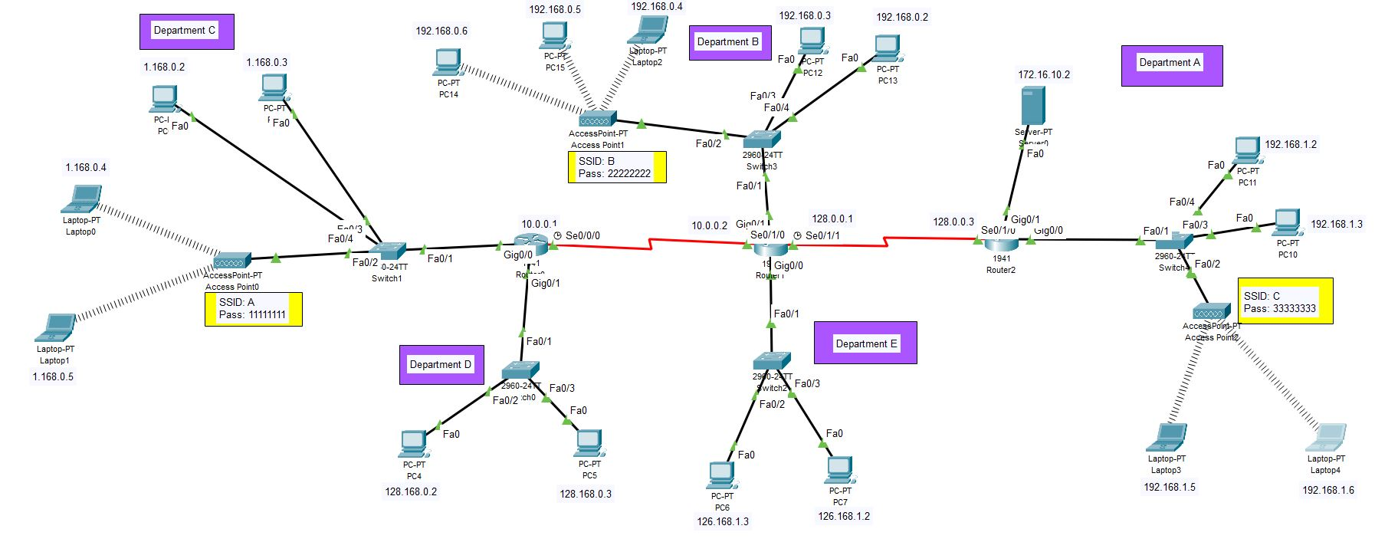

Slide 3
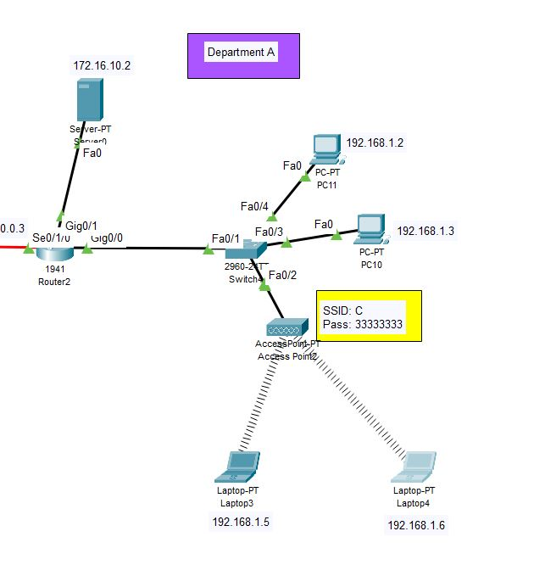
Part-1 Department A
Devices;
2960 switch-AP-2 wired connected PC – 2 laptop wireless connected – 1941 Router – Server
IP Addresses;
Server: 172.16.10.2
PC11: 192.168.1.2
PC10: 192.168.1.3
Laptop4: 192.168.1.6
Laptop3: 192.168.1.5

Slide 4
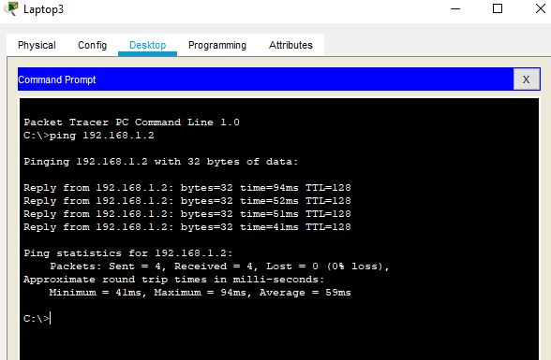
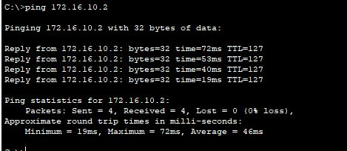
Ping test
Laptop4 to Server
Laptop3 to PC11

Slide 5
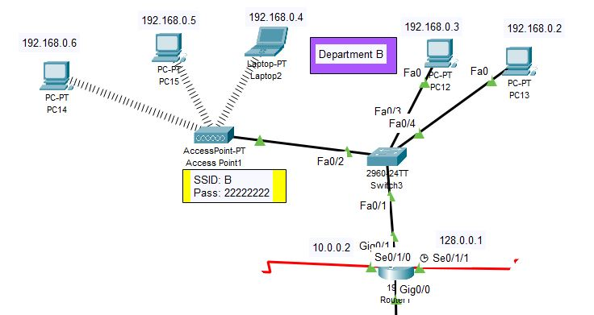
Part - 2 Department B
Devices;
1941 router – 2960 switch – 2 wired cable connected PC – AP – 2 wireless connected PC and laptop
IP addresses;
Pc12: 192.168.0.3
Pc13: 192.168.0.2
Laptop2: 192.168.0.4
Pc15: 192.168.0.5
Pc14: 192.168.0.6

Slide 6
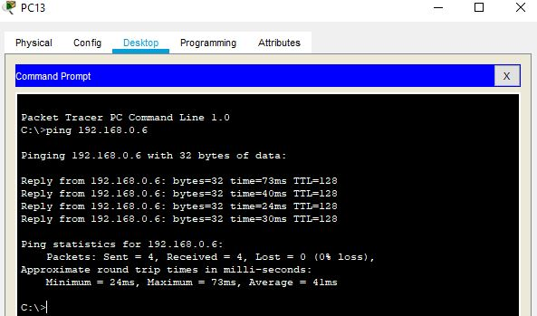
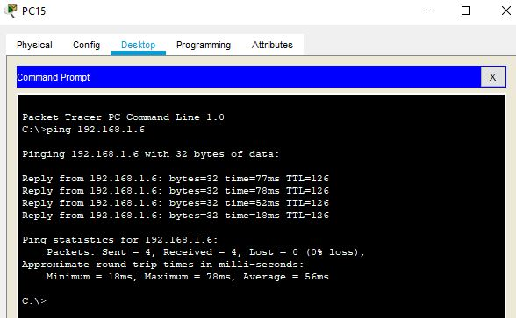
Ping test
Department B to Department A
Pc15 to Laptop 4
Pc13 to Pc14

Slide 7
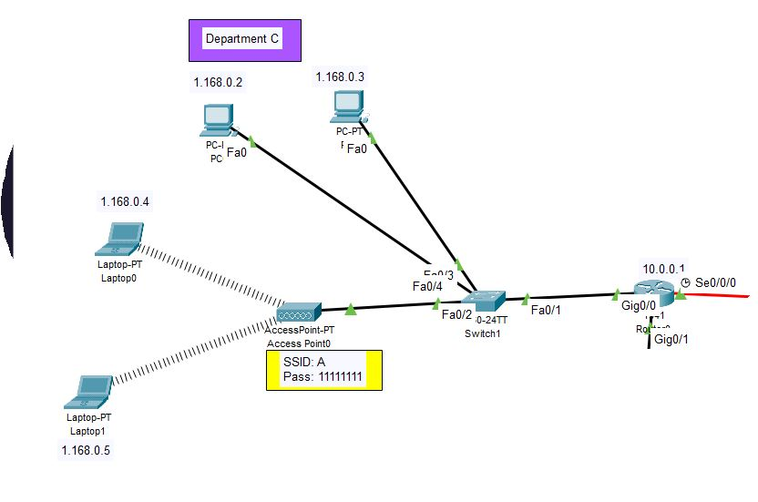
Part – 3 Department C
Devices;
1941 router – 2960 switch – 2 wired connected PC – AP – 2 wireless connected PC
IP Addresses;
Laptop1: 1.168.0.5
Laptop0: 1.168.0.4
Pc0: 1.168.0.2
Pc1: 1.168.0.3

Slide 8
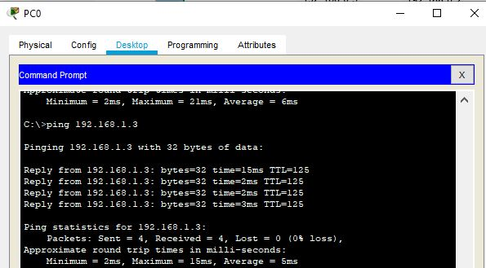
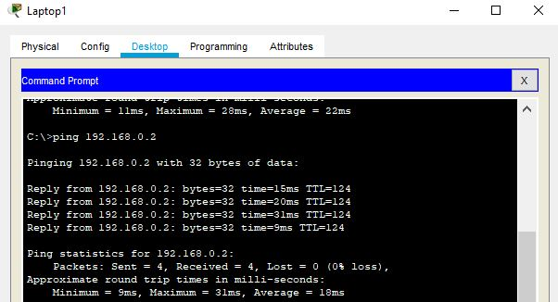
Ping Test
Department C to Department A
Pc0 to Pc10
Department C to Department B
Laptop1 to Pc13

Slide 9
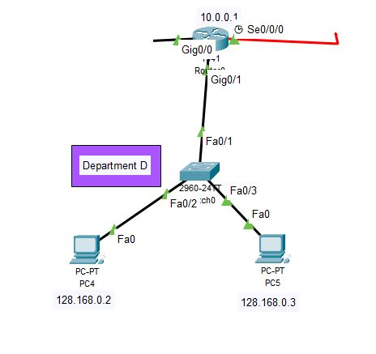
Part – 4 Department d
Device;
1941 router – 2960 switch – 2 wired connected PC
IP Addresses;
Pc4: 128.168.0.2
Pc5: 128.168.0.3

Slide 10
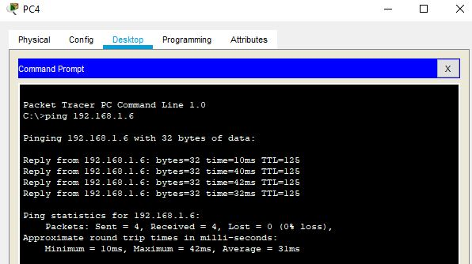
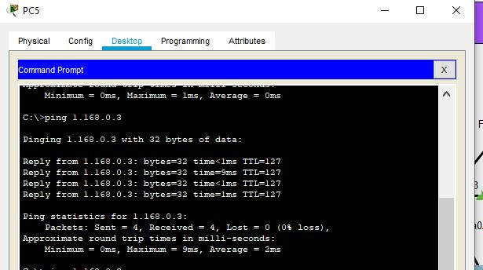
Ping test
Department D to Department A
Pc4 to Laptop 4
Department D to Department C
Pc5 to Pc1

Slide 11
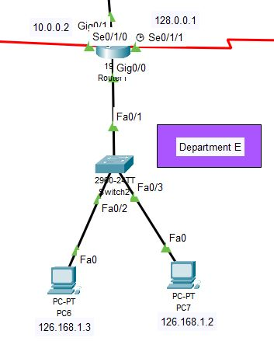
Part – 5 Department e
Devices;
1941 router – 2960 switch – 2 wired connected PC.
IP Addresses;
Pc6: 126.168.1.3
Pc7: 126.168.1.2

Slide 12
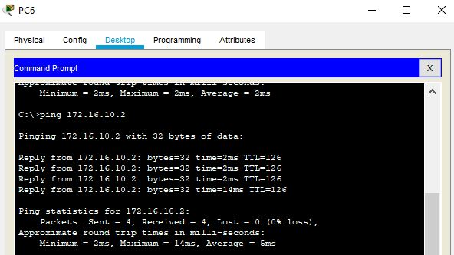
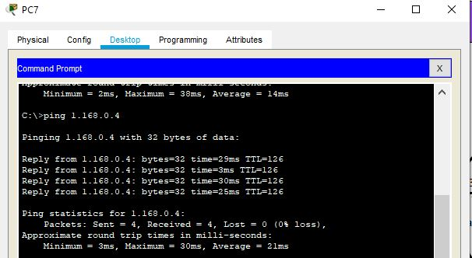
Ping Test
Department E to Server
Pc6 to Server
Department E to Department C
Pc7 to Laptop0

